Slide 1
BUILDING ORGANIZATIONAL CAPACITY TO ADDRESS HEALTH LITERACY: PERSPECTIVE FROM THE INDEPENDENT HEALTH INSURANCE FUNDS A COLLABORATIVE INCUBATOR WITH INSPIRATION FROM 3 CASE STUDIES
Luk Bruyneel
Department of Representation and Studies
Independent Health Insurance Funds

Slide 2
CONTENTS
WHO WE ARE AND WHAT WE DO (5′)
OUR VISION & ORGANIZATIONAL CAPACITY BUILDING FOR HEALTH LITERACY (5′)
COLLABORATIVE INCUBATOR – GUIDED BY 3 CASE STUDIES (5′)
Intermutualistic health advisors in Brussels & COLLABORATIVE INCUBATOR (20’)
Health literacy and treatment compliance of CHD patients & COLLABORATIVE INCUBATOR (20′)
Sensitization campaign among polymedicated elderly & COLLABORATIVE INCUBATOR (20′)

Slide 3
WHO WE ARE
LEGAL INTERLOCUTOR WITH REGARD TO THE GOVERNMENT AND THE ACTORS IN THE COMPULSORY INSURANCE FOR MEDICAL CARE AND DISABILITY BENEFITS
KNOWLEDGE CENTER FOR SPECIFIC MATTERS SUCH AS BELGIAN AND EUROPEAN REGULATIONS, MEDICAL AND LEGAL ASPECTS, STRATEGIC STUDIES, INTERNATIONAL TREATIES
SERVICE CENTER FOR OUR 3 INDEPENDENT HEALTH INSURANCE FUNDS FOR ACTIVITIES SUCH AS INFORMATION, DIGITIZATION, DISPUTE FOLLOW-UP, CREATION OF OWN TOOLS AND APPLICATIONS, PRICING, ETC
1
19%
2
WE
REPRESENT
2.254.340 MEMBERS
3

Slide 4
STRATEGIC PRIORITIES 2023-2028
WHAT WE DO
“CENTRED AROUND THESE PRIORITIES, THROUGH STRATEGIC PARTNERSHIPS, WE DEVELOP POLICIES AND MEASURES TO TRACK, EVALUATE AND IMPROVE HEALTH.”
WORK INCAPACITY
Micro
MENTAL HEALTH AND WELLBEING
ORGANISATION OF CARE
HEALTH PROMOTION AND PREVENTION
MEDICINES
CITIZEN
Better patient experiences, better outcomes, lower cost,
increased clinician wellbeing and increased health equity
DATA & DIGITALIZATION
GOVERNANCE
SERVICES
PROFESSIONALS & ORGANISATIONS
FEDERAL & FEDERATED AUTHORITIES AND POLICY MAKERS
QUINTUPLE AIM

Slide 5
THE DATA WE (AND OTHERS) EXPLOIT
COMPULSORY HEALTH INSURANCE
MEMBER IDENTIFICATION DATA
SOCIO-PROFESSIONAL DATA
BIM/MAF
HEALTHCARE
WORK INCAPACITY
FARMANET
HOSPITAL
RECOGNITION
DIAGNOSES
DECISIONS ADVISORY MDs
PAYMENTS
CONSOLIDATION IMA
PERMANENT SAMPLE
LINKING WITH EXTERNAL DATA
REIMBURSEMENTS (PROVIDERS AND AFFILIATES)
MEDICAL AGREEMENTS
COMPULSORY COMPLEMENTARY HEALTH INSURANCE
VOLUNTARY HEALTH INSURANCE
HOSPITALIA
DENTALIA
MEDICALIA

Slide 6
HEALTH INSURANCE LITERACY
Health insurance literacy: “The capacity to find and evaluate information about health plans, select the best plan given financial and health circumstances, and use the plan once enrolled”
3 health literacy challenges with regards to health insurance
People's ability to determine their coverage eligibility and navigate the enrolment system
The broad choice of plans and people's ability to compare insurance plans and coverage
Once people are enrolled, it is a challenge for them to use their coverage to connect to the care they need
1
2
3
Source: Health Insurance and Insights from Health Literacy, Roundtable on Health Literacy; Board on Population Health and Public Health Practice; Health and Medicine Division; National Academies of Sciences, Engineering, and Medicine, 2016

Slide 7
OUR VISION ON HEALTH PREVENTION AND HEALTH PROMOTION
In health promotion and prevention strategies…
Health Literacy is a property of a system and a fundamental lever to obtain the best results
The more people have the keys to finding, understanding, and using health information, the more they will be able to make informed decisions in favour of their health, to be involved, to play an active role (empowerment), and to participate in decision-making (shared decision).
Health literacy as a FOUNDATION for health promotion
Health Promotion
Health Literacy
Health literacy as a PARTNER of health promotion
Health literacy as an OUTCOME of health promotion
Health Literacy
Health promotion
Health Promotion
Health Literacy
Health literacy as an INFORMANT for health promotion
Health literacy as a DRIVER for health promotion
Health Literacy
Health Literacy
Health Promotion
Health promotion
Health Literacy
Health Literacy
Derived from Gugglberger, 2019. The multifaceted relationship between health promotion and health literacy

Slide 8
ORGANIZATIONAL CAPACITY BUILDING FOR HEALTH LITERACY
Conduct and support research that is implictly or explicitly related to health literacy
Involve communities and civil societies to reach vulnerable groups
STRENGTHS
RESEARCH AND EVALUATION
COLLABORATION & PARTNERSHIPS
LEADERSHIP INVOLVEMENT AND POLICY OUTREACH
DIGITAL TOOLS, APPLICATIONS & EDUCATIONAL RESOURCES
Highest levels of our organization embrace health literacy
Policy outreach involves continuous collaboration with various stakeholders
Partner with digital health solution providers to offer members access to user-friendly and secure digital health tools and applications, e.g. telemedicine platform Clear, concise, and easily understandable communication materials for our members

Slide 9
ORGANIZATIONAL CAPACITY BUILDING FOR HEALTH LITERACY
Always-on-strategy instead of ad hoc actions
Strengthen inter-sectoral partnerships
FUTURE
DIRECTIONS
RESEARCH AND EVALUATION
COLLABORATION & PARTNERSHIPS
LEADERSHIP INVOLVEMENT AND POLICY OUTREACH
DIGITAL TOOLS, APPLICATIONS & EDUCATIONAL RESOURCES
Include populations served in the design, implementation, and evaluation of health information and services.
Enrich health literacy data availability and usability
Focus on organizations and healthcare providers
Target population to needs via personalized health content and support

Slide 10
LET’S RUN A COLLABORATIVE INCUBATOR
Together develop a program/intervention/policy to promote health literacy
… let us embrace HealthNest’s aim to pool together your experiences with health literacy and define what approaches have the most potential to improve the situation on the ground
TARGETS?
Which population subgroups are targeted by the program / intervention / policy?
PROGRAM?
What does the program / intervention / policy entail? Is it tailored? Barriers/facilitators (e.g. effectively reach the target population?) Required resources?
HOW TO MEASURE SUCCES?
What are expected individual / social benefits of the program / intervention / policy?
PARTNERS?
Who are key players to design, deliver and maximize the impact of the program / intervention / policy?
and let’s see what has to offer…
Notes:
We geven een concreet voorbeeld van wat we hiermee bedoelen (anders dan de 3 voorbeelden die we voorstellen)

Slide 11
LET’S RUN A COLLABORATIVE INCUBATOR
Together develop a program/intervention/policy to promote health literacy
…inspiration from 3 case studies
1
Intermutualistic health advisors in Brussels
Improving health literacy and treatment compliance of CHD patients at risk trough nurse-led health coaching: a pre-test post-test study
Sensitization campaign among community-dwelling polymedicated people aged 75 and over
2
Refine
3
Refine

Slide 12
LET’S RUN A COLLABORATIVE INCUBATOR
AIM
RULES
Build momentum to kickstart new ideas to tackle health literacy challenges/problems
Encourage exchange between people who wouldn’t normally meet
Level playing field
Get as many people actively involved in the discussion as possible
WE COLLATE INPUT
& TRUST YOU CREATE FOLLOW-UP ACTIVITY
See https://www.bath.ac.uk/publications/guidance-on-how-to-run-a-collaborative-incubator/attachments/Incubator_guidance.pdf

Slide 13
INTERMUTUALISTIC
HEALTH ADVISORS IN BRUSSELS
1
TEAM
10 FTE + SUPERVISION/COORDINATION
PROACTIVE TELEPHONE CONTACT
FUNDING

Slide 14
HISTORY
COVID-19
OBJECTIVES
IDENTIFY/SUPPORT CARE NEED
Understand, analyse needs
Inform and/or reorient
REINFORCE HEALTH LITERACY
IDENTIFY STRUCTURAL BARRIERS AND REPORT TO STAKEHOLDERS
PROACTIVE TELEPHONE CONTACT

Slide 15
METHODOLOGY
PROACTIVE TELEPHONE CONTACT
Multiple avenues for follow-up
TARGET GROUP
2021
2022
>65yo, live alone, preferential reimbursement, brussels
35-44yo, preferential reimbursement, brussels
>65yo, no preferential reimbursement, brussels
Single parent families, brussels
SENSITIZATION SESSIONS
On demand of local organizations
TARGET GROUP
Focus on, but not limited to:
>65yo, no preferential reimbursement, brussels
Single parent families, brussels

Slide 16
HOW WE REINFORCE HEALTH LITERACY
HOLISTIC HEALTH = PHYSICAL, MENTAL, SOCIAL
HEALTH LITERACY
GLOBAL MEDICAL FILE
HOSPITALISATION COSTS
INCREASED INTERVENTION BENEFICIARY
THIRD PARTY PAYMENT
DIFFERENT TYPES OF ASSURANCES
CONVENTION STATUS
…
CHRONIC DISEASES
VACCINATION
CANCER SCREENINGS
DENTAL CARE PREVENTION
NUTRITION
SRH
MENTAL HEALTH
POLYMEDICATION
…
HEALTH TOPICS
HEALTH INSURANCE & ACCESS TO CARE SYSTEM
SOCIAL CONTEXT
FINANCIAL AID
RECOGNITION CAREGIVER STATUS
AUTONOMY AT HOME
HOUSING
ACCESS TO LEISURE
SOCIAL ISOLATION
…

Slide 17
HOW WE REINFORCE HEALTH LITERACY
INDIVIDUAL APPROACH (phone, appointment, home visit)
Identify the needs in term of health literacy
Give the right informations
Make sure the person understands
Plan a follow-up
COLLECTIVE APPROACH ( information sessions)
Topics (diabetes, health insurance, screening of cancers, tobacco prévention, …)

Slide 18
DEVELOP A PROGRAM/INTERVENTION/POLICY TO PROMOTE HEALTH LITERACY
TARGETS?
Which population subgroups are targeted by the program/intervention/policy?
PLENARY DISCUSSION

Slide 19
2
HEALTH LITERACY AND TREATMENT COMPLIANCE OF CHD PATIENTS
A pretest-posttest study
To evaluate the clinical effectiveness of a 6‐month coaching program on patient health literacy (primary outcome) and on medication beliefs, motivation for lifestyle changes and treatment adherence (secondary outcomes).
To evaluate the process of the 6-month coaching program, as experienced by patients and providers.
1
2

Slide 20
Aged 40-75
Concomitant treatment with a lipid lowering agent, an antihypertensive medication (or combination of several of them) and nitrates or molsidomine, as documented in our databases
Medication possession ratio (MPR) less than 80% for at least 2 out of 3 medications

Slide 21
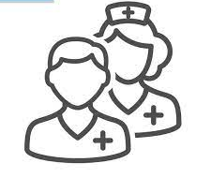
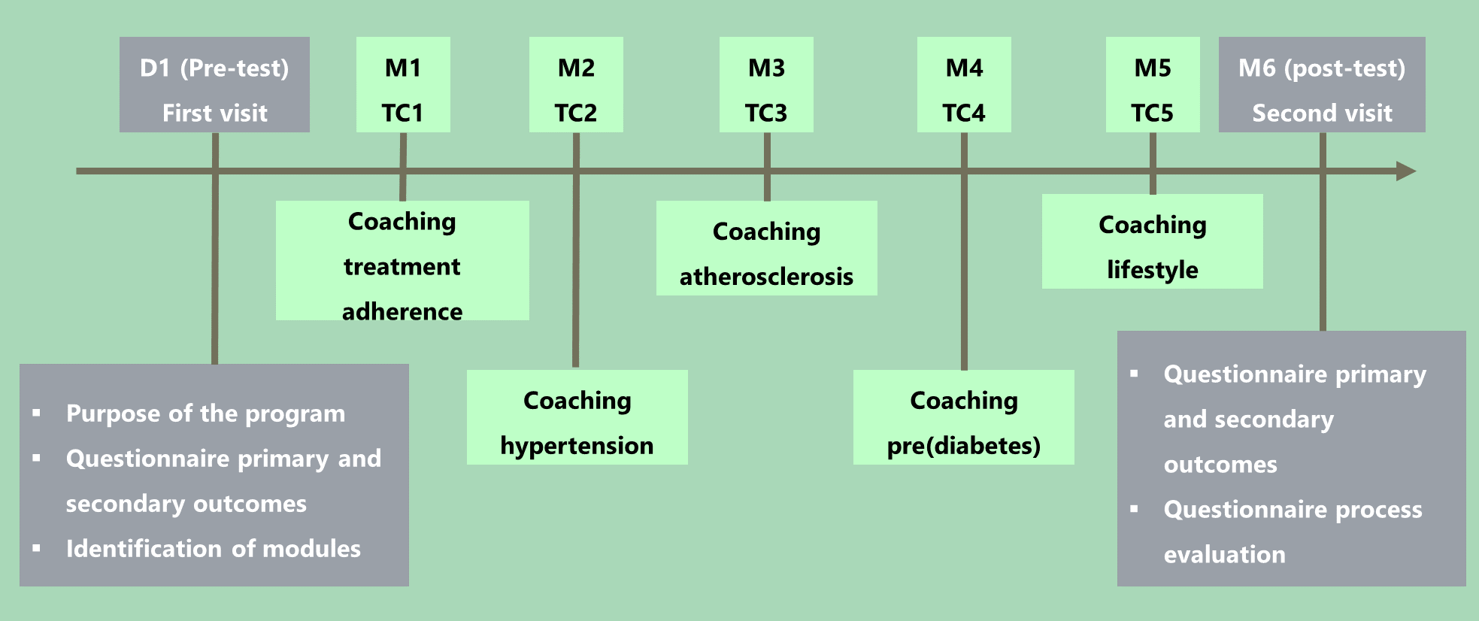
Modules offered via telephone contacts (TC), approximately 1 month apart
Identification of risk factors contributed to selection of modules
Coaching program offered by two nurses (partnership with Modis)

Slide 22
CHANGES TO PLANNED ANALYSIS
Second invitation wave was planned for patients with an MPR<80% for at least 1 medication to complete the study population
As this study population is a population at high risk for serious complications after COVID-19-infection and the first contact with patients is a face-to-face visit, it was decided not to continue with the second wave
n = 47

Slide 23
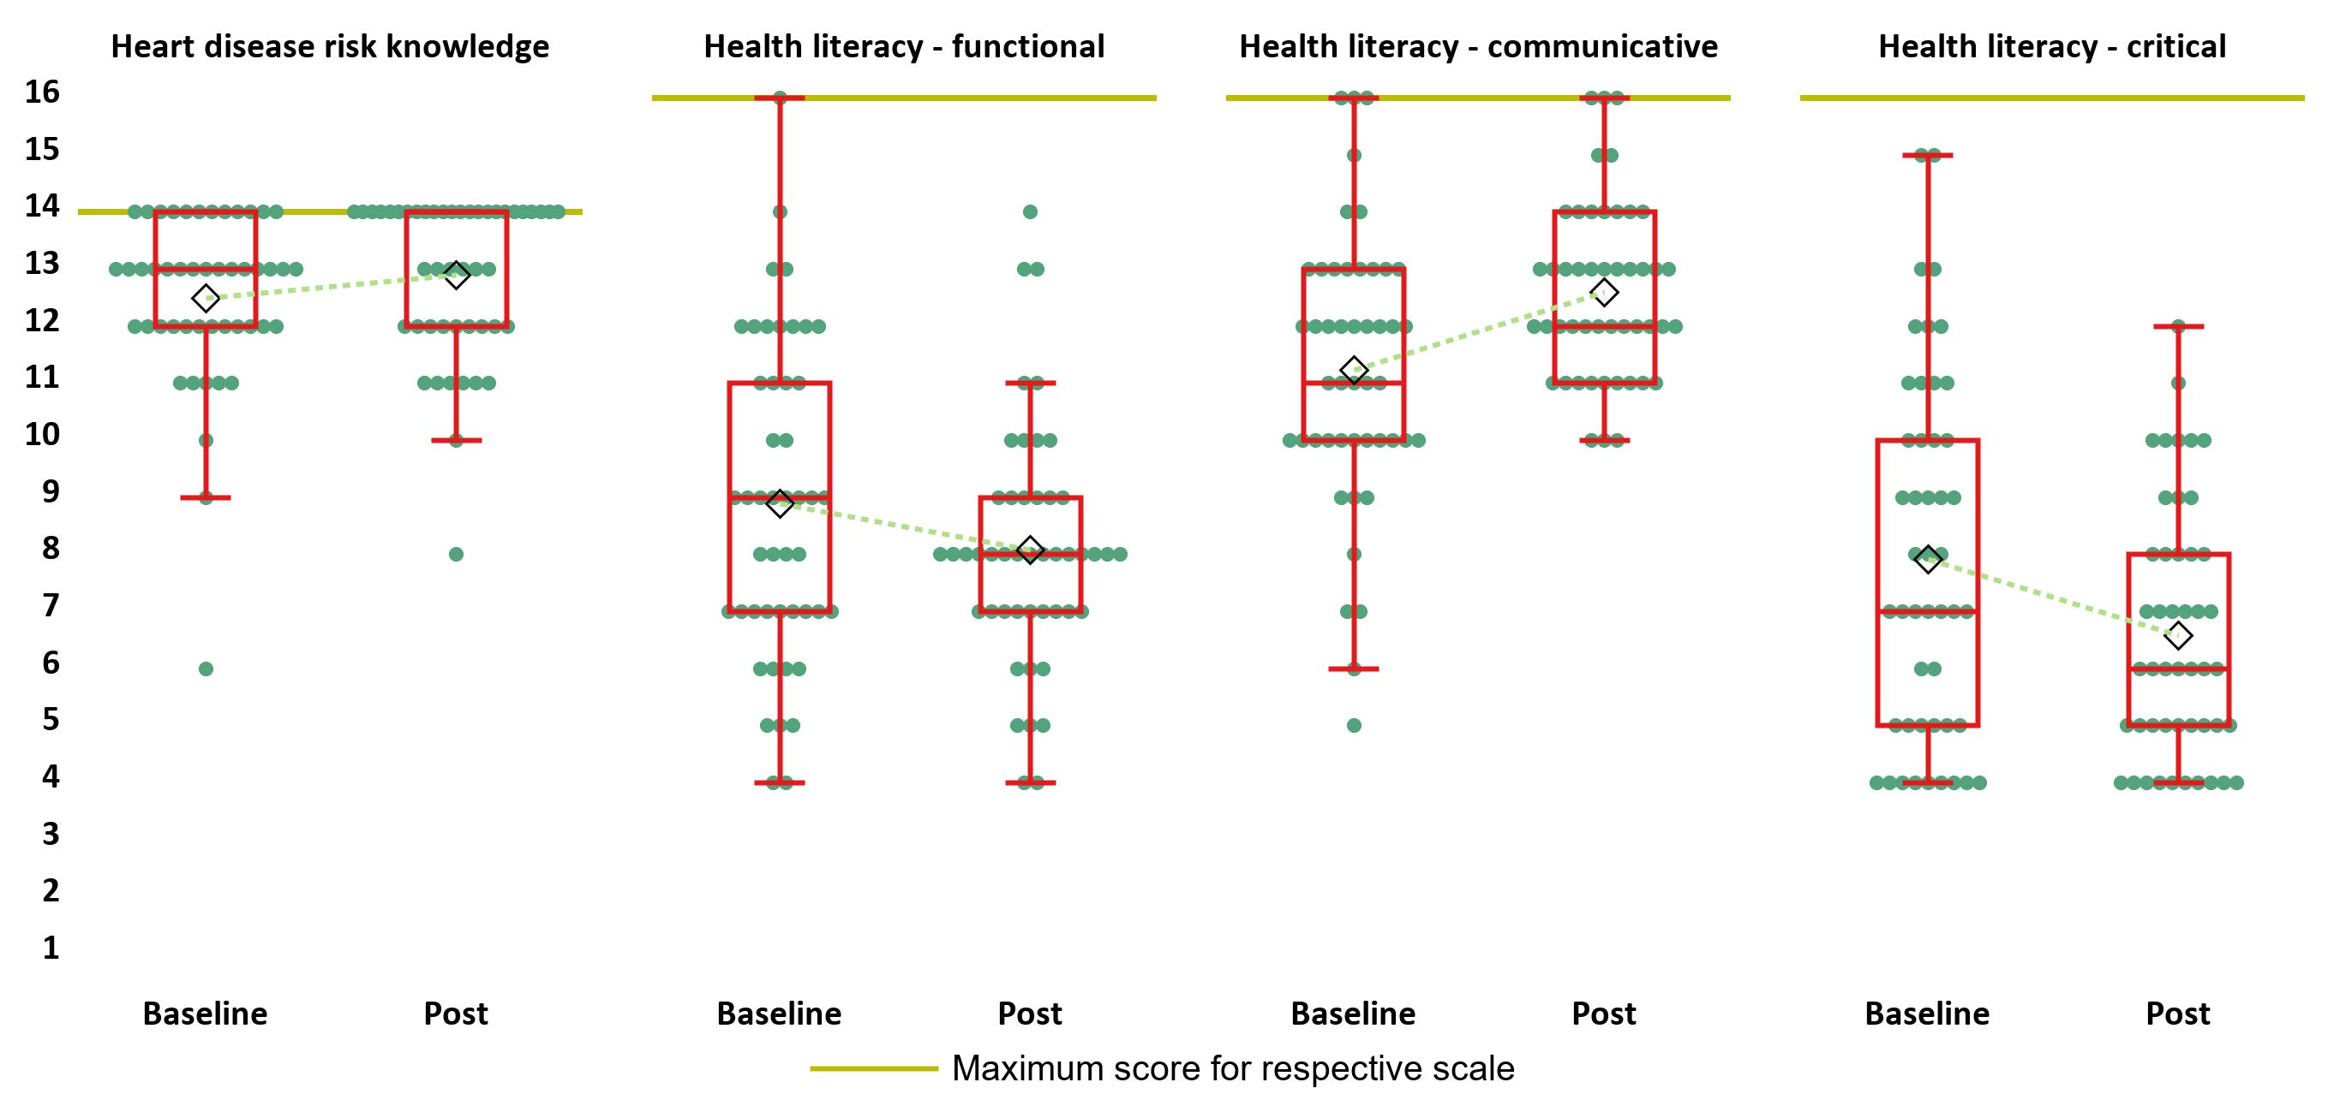
HEALTH LITERACY
Heart Disease Fact Questionnaire
Heart-Failure Specific Health Literacy scale

Slide 24
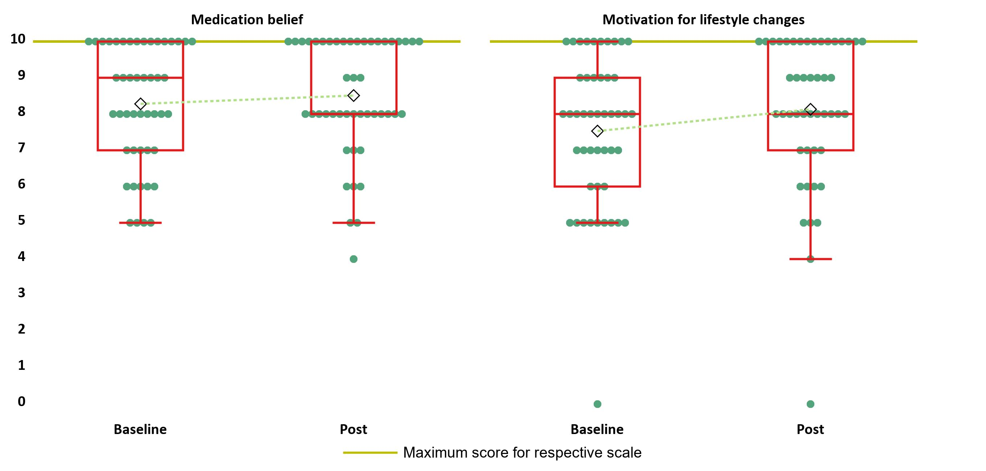
MEDICATION BELIEF AND MOTIVATION FOR LIFESTYLE CHANGES
Both are visual analogue scores 0-10

Slide 25
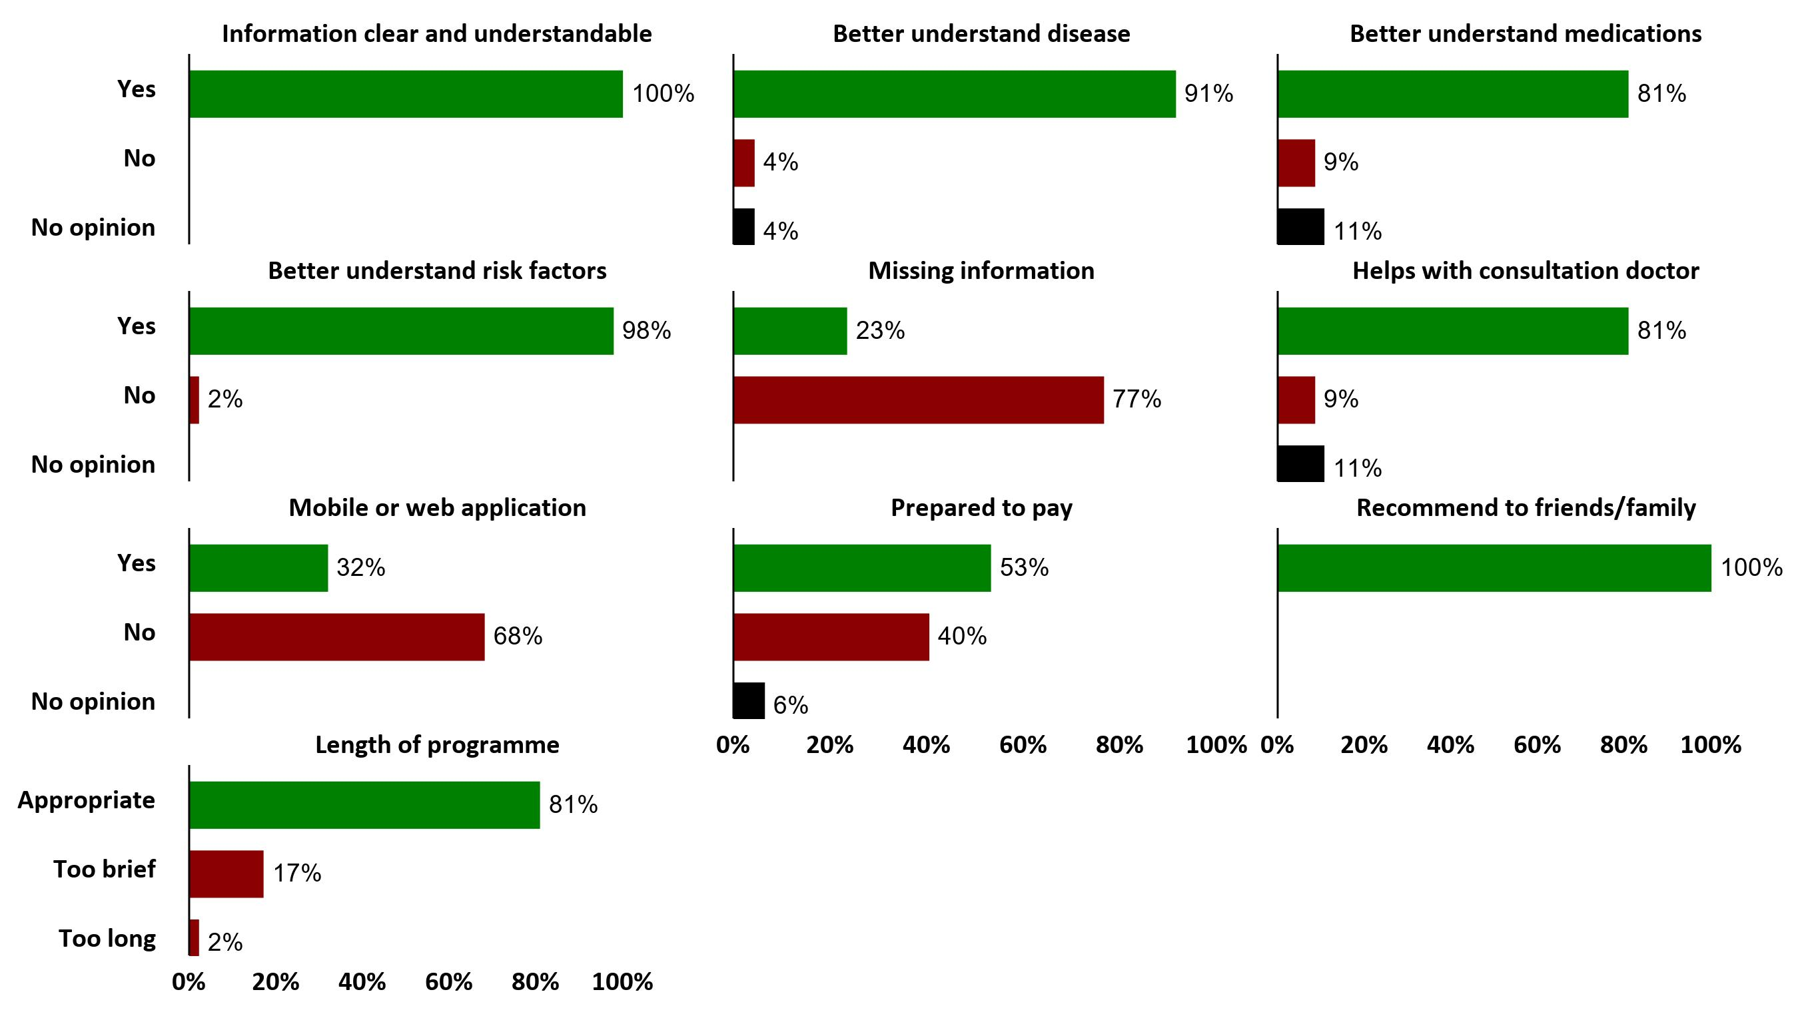
PROCES EVALUATION AMONG PATIENTS

Slide 26
DEVELOP A PROGRAM/INTERVENTION/POLICY TO PROMOTE HEALTH LITERACY
PROGRAM?
What does the program/intervention/policy entail? Is it tailored? Barriers/facilitators (e.g. effectively reach the target population?) Required resources?
SMALL GROUP DISCUSSIONS (5-6 PERSONS) BASED ON THE INPUT FROM ”TARGETS”
REFINEMENT OF “TARGETS” MAY BE DESIRABLE
DON’T FORGET TO PRESENT YOURSELF
TO YOUR GROUP MEMBERS

Slide 27
3
SENSITIZATION CAMPAIGN AMONG POLYMEDICATED PEOPLE AGED +75
Raise awareness of polymedication among polymedicated people over 75, identified on the basis of routinely collected reimbursement data, by means of a leaflet and familiarize them with various services that can assist them in the correct monitoring of their medication use, and to measure the effectiveness of such an awareness campaign.

Slide 28
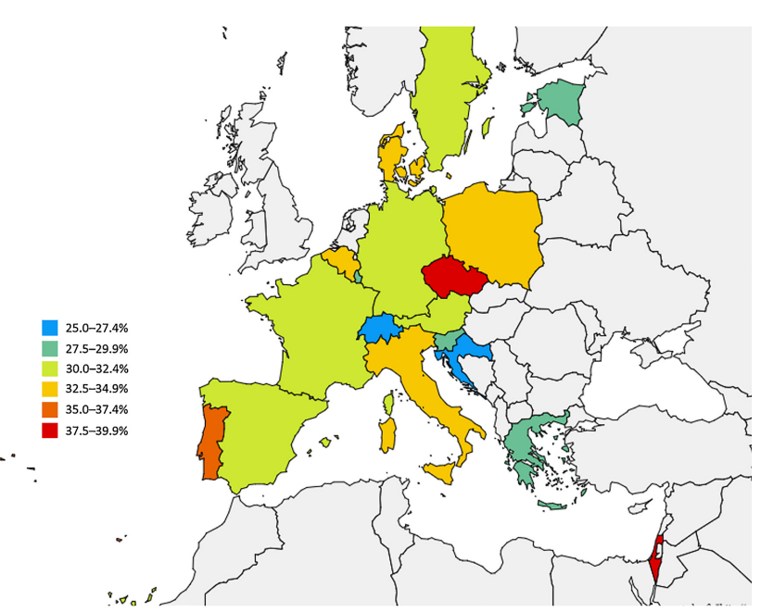
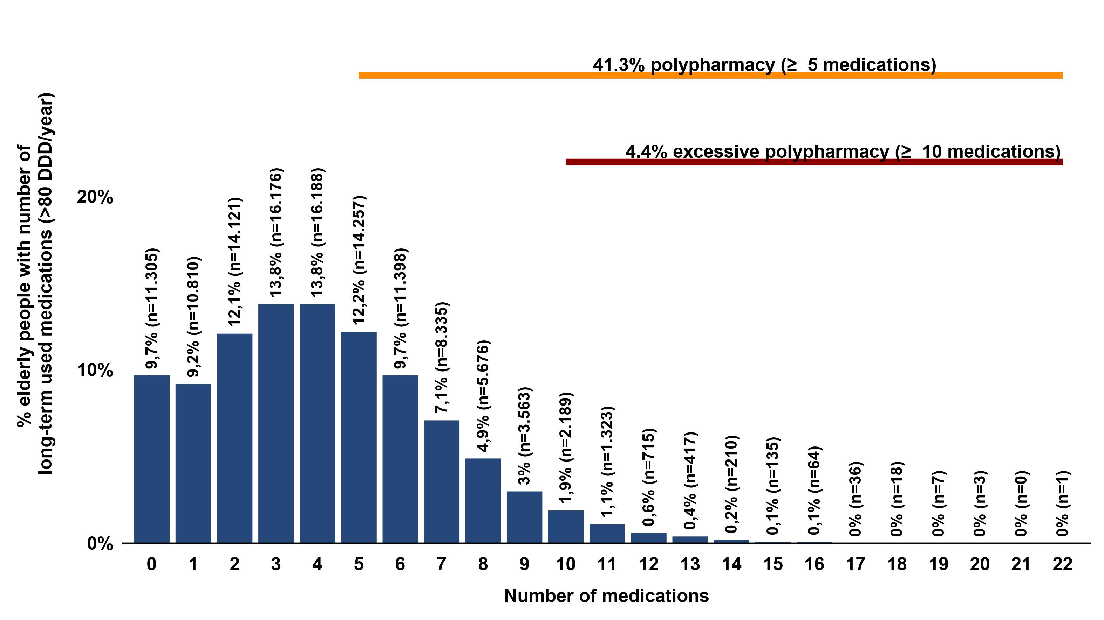
Prevalence of polypharmacy in elderly (75 years or older) among members of the Independent Health Insurance Funds (collaboration with University Hospitals Leuven)
Prevalence of polypharmacy in elderly (65 years or older) among 17 European countries and Israel
Midão L, Giardini A, Menditto E, Kardas P, Costa E. Polypharmacy prevalence among older adults based on the survey of health, ageing and retirement in Europe. 2018;

Slide 29
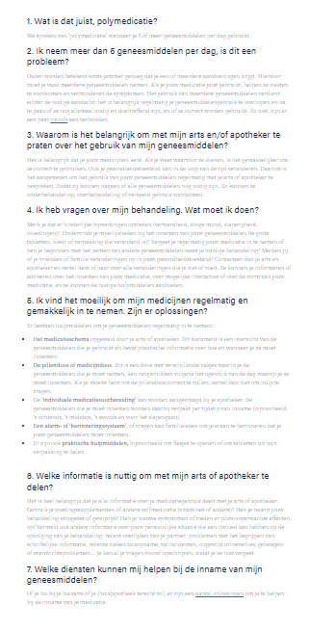
DEVELOPMENT OF A FOLDER ON POLYPHARMACY & AVAILABLE TOOLS
Q&A based
Easy to comprehend
Available online
Reviewed by APB & OPHACO
Survey attached

Slide 30
IDENTIFY AND CONTACT POLYMEDICATED ELDERLY
IDENTIFY: based on 2021 consumption
CONTACT: only if known email-address
Advantage: affordable
Limits:
Biased selection
Email-address valid?
Email-address of targeted person?

Slide 31
EVALUATE INTERVENTION
IMPACT
LESSONS LEARNED
CHALLENGES
WAY FORWARD
Easy to comprehend (9/10)
Useful (2/3)
But no behavioural change
Limited knowledge of (use of) services (GMD, GFD, reference pharmacy)
Role for insurance funds to provide easy to comprehend, tailored information
Collaboration with external actors to ensure information is easy to understand
How to reach other groups cost-efficiently?
Information or call to action?
Diversifying target groups:
Chronic illnesses
Preventive health (dental care,…)
Diversifying themes:
Non take-up of rights/services
Continuity of care
Automatisation

Slide 32
DEVELOP A PROGRAM/INTERVENTION/POLICY TO PROMOTE HEALTH LITERACY
HOW TO MEASURE SUCCES?
What are expected individual/social benefits of the program/intervention/policy?
SMALL GROUP DISCUSSIONS (5-6 PERSONS)
BASED ON THE INPUT FROM ”TARGETS” AND “PROGRAM”
REFINEMENT OF “PROGRAM” MAY BE DESIRABLE

Slide 33
DEVELOP A PROGRAM/INTERVENTION/POLICY TO PROMOTE HEALTH LITERACY
PARTNERS?
Who are key players to design, deliver and maximize the impact of the program/intervention/policy?
PLENARY DISCUSSION

Slide 34
& Health Literacy
HOW TRUSTWORTHY IS ChatGPT IN ANSWERING THE QUESTION
CAN YOU EXPLAIN TO ME IN SIMPLE TERMS HOW I CAN LOWER MY CHOLESTEROL?

Slide 35
& Health Literacy
Notes:
Video is backup voor wanneer internetconnectie faalt

Slide 36
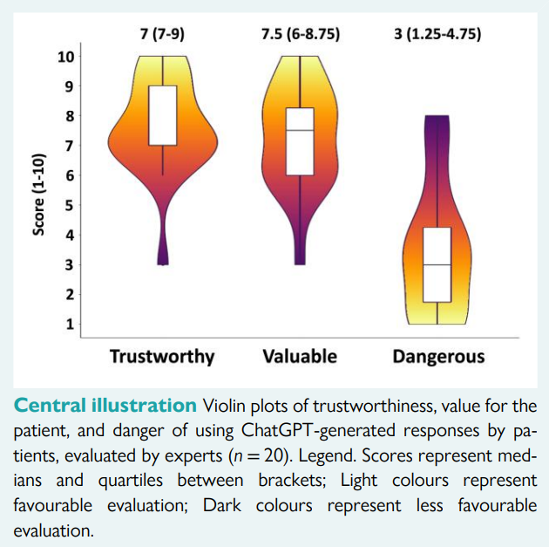
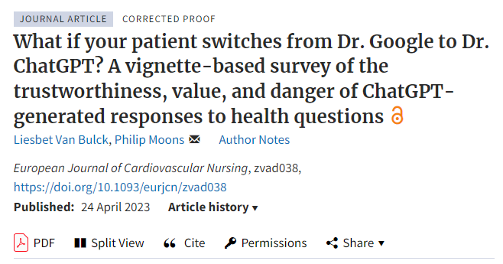
& Health Literacy

Slide 37
& Health Literacy

Slide 38
& Health Literacy
Example. What would a good health literacy intervention be with regards to teenage pregnant women? Who are key partners and stakeholders? And how can we measure success?
A good health literacy intervention for teenage pregnant women should focus on providing comprehensive and age-appropriate information and education to empower them to make informed decisions about their health and the health of their babies. Here are some key components that could be included in such an intervention:
Prenatal education: Provide information on prenatal care, nutrition, exercise, and common discomforts during pregnancy. This can be done through group sessions, one-on-one counseling, or educational materials.
Sexual and reproductive health education: Offer information on contraception, sexually transmitted infections, and healthy relationships. This can help prevent future unintended pregnancies and promote overall reproductive health.
Parenting skills: Provide guidance on newborn care, breastfeeding, infant nutrition, and early childhood development. This can help teenage mothers feel more confident and competent in their parenting role.
Emotional support: Address the emotional and psychological challenges that teenage pregnant women may face. Offer counseling services, support groups, and referrals to mental health professionals as needed.
Life skills training: Provide education on essential life skills such as communication, decision-making, problem-solving, and goal-setting. These skills can help teenage mothers navigate challenges and make positive life choices.
Key partners and stakeholders in a health literacy intervention for teenage pregnant women may include:
Healthcare providers: Collaborate with obstetricians, gynecologists, pediatricians, and nurses who provide prenatal and postnatal care. They can contribute their expertise and ensure that accurate information is being shared.
Schools: Partner with schools to incorporate reproductive health education into the curriculum and provide support services for pregnant and parenting teenagers.
Community organizations: Collaborate with local community organizations that work with teenage populations, such as youth centers, nonprofits, and religious groups. They can help in reaching out to the target audience and providing additional resources and support.
Public health agencies: Work with local or national health departments to access resources, guidelines, and funding opportunities. They can also provide expertise in program development and evaluation.
Parents and families: Involve the families of teenage pregnant women to provide support, education, and encouragement throughout the pregnancy and beyond.
Measuring success in a health literacy intervention for teenage pregnant women can be done through various methods, including:
Pre- and post-assessments: Conduct assessments at the beginning and end of the intervention to measure changes in knowledge, attitudes, and behaviors related to pregnancy, childbirth, and parenting.
Surveys and questionnaires: Administer surveys to participants to gather feedback on the effectiveness and satisfaction with the intervention. This can help identify areas for improvement and assess the overall impact.
Health outcomes: Track health outcomes such as prenatal care utilization, birth outcomes, rates of sexually transmitted infections, and infant health and development indicators.
Self-efficacy and empowerment: Measure changes in self-efficacy and empowerment among teenage mothers, such as their confidence in making informed decisions about their health and parenting.
Long-term follow-up: Conduct follow-up assessments several months or years after the intervention to assess the sustained impact on health behaviors and outcomes.
By utilizing these measures, it is possible to evaluate the effectiveness of the intervention and make adjustments as needed to improve outcomes for teenage pregnant women.

Slide 40
NEXT SLIDES ARE PRINTED TO SUPPORT PARTICIPANTS IN THEIR SMALL GROUP DISCUSSION (PARTICULARLY DURING “PROGRAM” DISCUSSION)

Slide 41
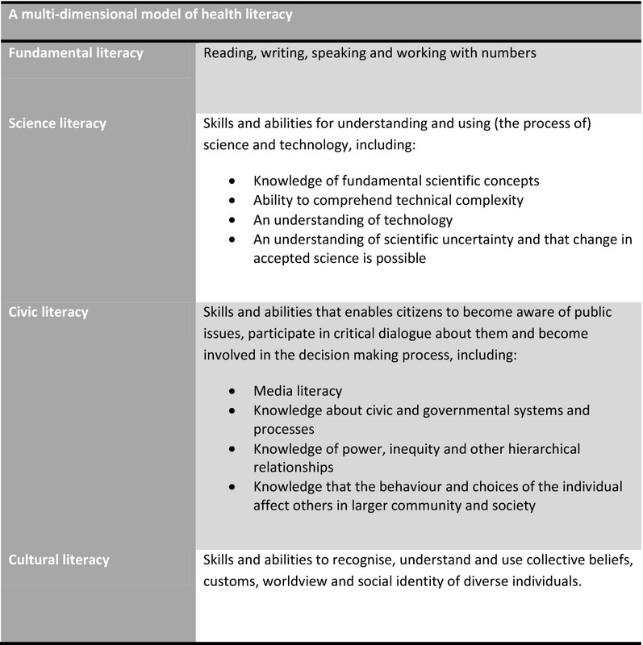
Zarcadoolas et al 2006 Advancing Health Literacy: A Framework for Understanding and Action.

Slide 43
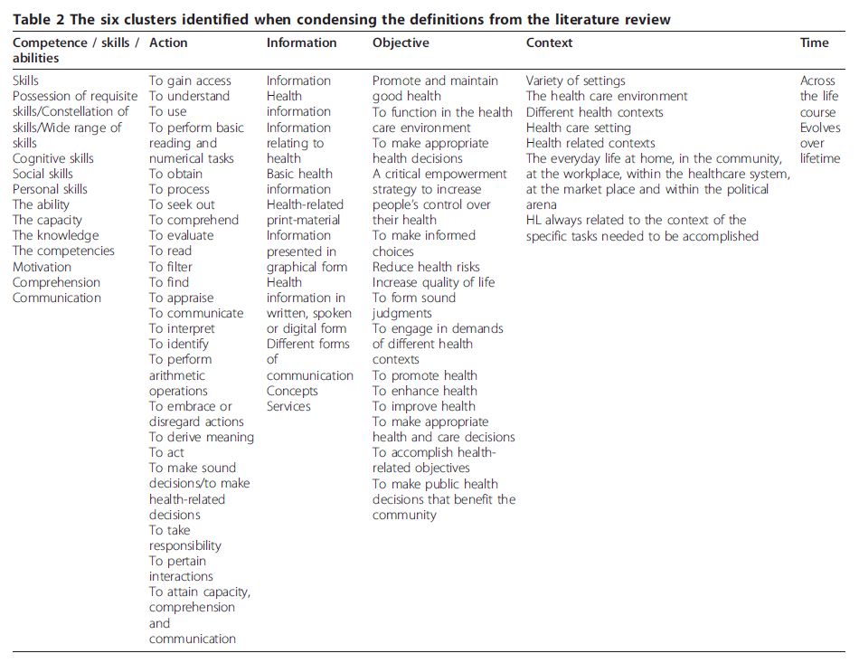
Sørensen et al. 2012 Health Literacy and public health: a systematic review and integration of definition and models

